Slide 1
Diagnosis

Slide 2
Design & Creativity
Configuration
Diagnosis
Design
Creativity

Slide 3
Lesson Preview
Defining diagnosis
Data and hypothesis spaces
Mapping data to hypotheses
Two views of diagnosis

Slide 4
Patient:
A: Normal
B: High
C: Low
D: Normal
E: Normal
F: Normal
G: Normal
H: Low
Illnesses:
ο Alphaitis: Elevated A, Reduced C, Elevated F
ο Betatosis: Elevated B, Reduced C, Elevated E, Reduced H
ο Gammanoma: Elevated D, Elevated E, Elevated F
ο Deltacol: Elevated B, Reduced C
ο Epsicusus: Reduced H
ο Zetad: Elevated B, Reduced C, Reduced E, Reduced F
ο Etaemia: Elevated A, Reduced D, Reduced H
ο Thetadesis: Elevated B, Reduced C, Reduced H
ο Iotalgia: Elevated A, Reduced E, Elevated F, Elevated G
ο Kappacide: Reduced A, Reduced F, Reduced G
ο Lambdacrite: Reduced A, Reduced E, Reduced F, Reduced G
ο Mutension: Elevated A, Elevated G
What illness (or set of illnesses) would you use to diagnose this patient?

Slide 5
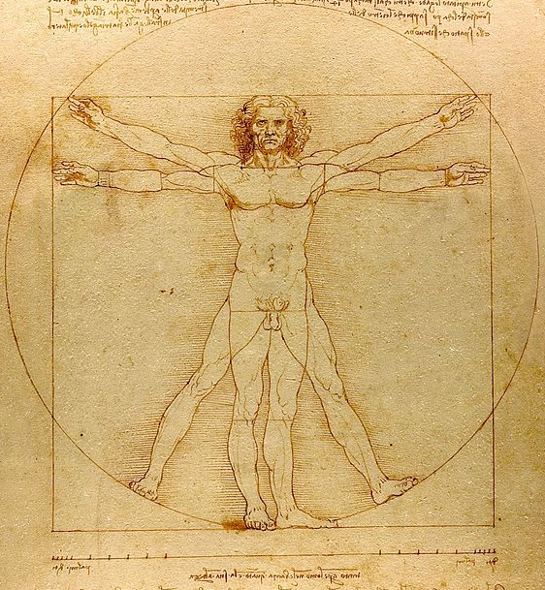
Diagnosis: To determine what is wrong with a malfunctioning device.

Slide 6
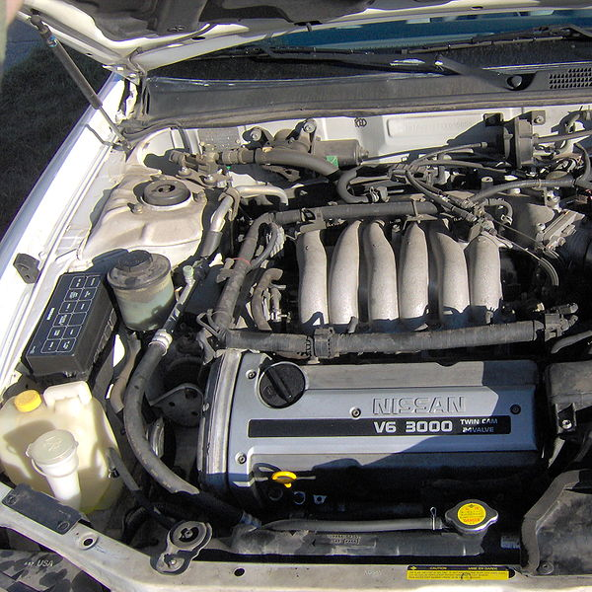

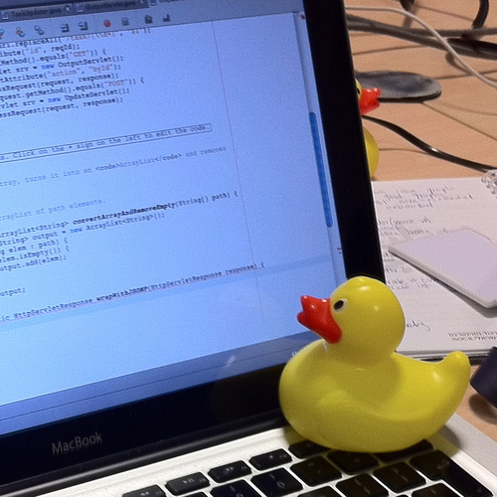
Diagnosis: To determine what is wrong with a malfunctioning device.
Notes:
Image credit:
Tom Morris, https://commons.wikimedia.org/wiki/User:Tom_Morris

Slide 7
Data Space
D₁
D₂
D₃
D₄
D₅
D₆
D₇
D₈
D₉
D₁₀
D₁₁
D₁₂
…
D_{N}
Hypothesis Space
H₁
H₂
H₃
H₄
H₅
H₆
H₇
H₈
H₉
H₁₀
H₁₁
H₁₂
…
H_{N}

Slide 8
Data Space
D₁
D₂
D₃
D₄
D₅
D₆
D₇
D₈
D₉
D₁₀
D₁₁
D₁₂
…
D_{N}
Hypothesis Space
H₁
H₂
H₃
H₄
H₅
H₆
H₇
H₈
H₉
H₁₀
H₁₁
H₁₂
…
H_{N}
Abstract

Slide 9
Data Space
D₁
D₂
D₃
D₄
D₅
D₆
D₇
D₈
D₉
D₁₀
D₁₁
D₁₂
…
D_{N}
Hypothesis Space
H₁
H₂
H₃
H₄
H₅
H₆
H₇
H₈
H₉
H₁₀
H₁₁
H₁₂
…
H_{N}
Map
Abstract

Slide 10
Data Space
D₁
D₂
D₃
D₄
D₅
D₆
D₇
D₈
D₉
D₁₀
D₁₁
D₁₂
…
D_{N}
Hypothesis Space
H₁
H₂
H₃
H₄
H₅
H₆
H₇
H₈
H₉
H₁₀
H₁₁
H₁₂
…
H_{N}
Map
Abstract
Refine

Slide 11
Data Space
D₁
D₂
D₃
D₄
D₅
D₆
D₇
D₈
D₉
D₁₀
D₁₁
D₁₂
…
D_{N}
Hypothesis Space
H₁
H₂
H₃
H₄
H₅
H₆
H₇
H₈
H₉
H₁₀
H₁₁
H₁₂
…
H_{N}
Map
Abstract
Refine

Slide 12
Problem #1: One data point, multiple hypotheses.
Data Space
D₁
D₂
D₃
D₄
D₅
D₆
D₇
D₈
D₉
…
D_{N}
Hypothesis Space
H₁
H₂
H₃
H₄
H₅
H₆
H₇
H₈
H₉
…
H_{N}

Slide 13
Problem #2: One hypothesis, multiple sets of data.
Data Space
D₁
D₂
D₃
D₄
D₅
D₆
D₇
D₈
D₉
…
D_{N}
Hypothesis Space
H₁
H₂
H₃
H₄
H₅
H₆
H₇
H₈
H₉
…
H_{N}

Slide 14
Problem #3: Multiple hypotheses, multiple sets of data.
Data Space
D₁
D₂
D₃
D₄
D₅
D₆
D₇
D₈
D₉
…
D_{N}
Hypothesis Space
H₁
H₂
H₃
H₄
H₅
H₆
H₇
H₈
H₉
…
H_{N}

Slide 15
Problem #4: Mutually exclusive hypotheses.
Data Space
D₁
D₂
D₃
D₄
D₅
D₆
D₇
D₈
D₉
…
D_{N}
Hypothesis Space
H₁
H₂
H₃
H₄
H₅
H₆
H₇
H₈
H₉
…
H_{N}
But H₃ and H₆ are mutually exclusive.

Slide 16
Problem #5: Interacting data points.
Data Space
D₁
D₂
D₃
D₄
D₅
D₆
D₇
D₈
D₉
…
D_{N}
Hypothesis Space
H₁
H₂
H₃
H₄
H₅
H₆
H₇
H₈
H₉
…
H_{N}
But D₅ and D₉ cancel each other out.

Slide 17
Rule
Cause
Effect

Slide 18
Deduction: Given the rule and the cause, deduce the effect.
Rule
Cause
Effect

Slide 19
Induction: Given a cause and an effect, induce a rule.
Rule
Cause
Effect

Slide 20
Abduction: Given a rule and an effect, abduce a cause.
Rule
Cause
Effect

Slide 21
Patient:
A: Normal
B: High
C: Low
D: Normal
E: Normal
F: Normal
G: Normal
H: Low
Illnesses:
ο Alphaitis: Elevated A, Reduced C, Elevated F
ο Betatosis: Elevated B, Reduced C, Elevated E, Reduced H
ο Gammanoma: Elevated D, Elevated E, Elevated F
ο Deltacol: Elevated B, Reduced C
ο Epsicusus: Reduced H
ο Zetad: Elevated B, Reduced C, Reduced E, Reduced F
ο Etaemia: Elevated A, Reduced D, Reduced H
ο Thetadesis: Elevated B, Reduced C, Reduced H
ο Iotalgia: Elevated A, Reduced E, Elevated F, Elevated G
ο Kappacide: Reduced A, Reduced F, Reduced G
ο Lambdacrite: Reduced A, Reduced E, Reduced F, Reduced G
What illness (or set of illnesses) would you use to diagnose this patient?

Slide 22
Criteria for Choosing Hypotheses
1. Hypotheses must cover as much of the data as possible.
Data Space
D₁
D₂
D₃
D₄
D₅
D₆
D₇
D₈
D₉
…
D_{N}
Hypothesis Space
H₁
H₂
H₃
H₄
H₅
H₆
H₇
H₈
H₉
…
H_{N}

Slide 23
Criteria for Choosing Hypotheses
1. Hypotheses must cover as much of the data as possible.
2. The smallest number of hypotheses ought to be used.
Data Space
D₁
D₂
D₃
D₄
D₅
D₆
D₇
D₈
D₉
…
D_{N}
Hypothesis Space
H₁
H₂
H₃
H₄
H₅
H₆
H₇
H₈
H₉
…
H_{N}

Slide 24
Criteria for Choosing Hypotheses
1. Hypotheses must cover as much of the data as possible.
2. The smallest number of hypotheses ought to be used.
3. Some hypotheses may be more likely than others.
Data Space
D₁
D₂
D₃
D₄
D₅
D₆
D₇
D₈
D₉
…
D_{N}
Hypothesis Space
H₁
H₂
H₃
H₄
H₅
H₆
H₇
H₈
H₉
…
H_{N}

Slide 25
Patient:
A: Normal
B: High
C: Low
D: Normal
E: Normal
F: Low
G: Normal
H: Low
Illnesses:
ο Alphaitis: Elevated A, Reduced C, Elevated F
ο Betatosis: Elevated B, Reduced C, Elevated E, Reduced H
ο Gammanoma: Elevated D, Elevated E, Elevated F
ο Deltacol: Elevated B, Reduced C
ο Epsicusus: Reduced H
ο Zetad: Elevated B, Reduced C, Reduced E, Reduced F
ο Etaemia: Elevated A, Reduced D, Reduced H
ο Thetadesis: Elevated B, Reduced C, Reduced H
ο Iotalgia: Elevated A, Reduced E, Elevated F, Elevated G
ο Kappacide: Reduced A, Reduced F, Reduced G
ο Lambdacrite: Reduced A, Reduced E, Reduced F, Reduced G
ο Mutension: Elevated A, Elevated G
What illness (or set of illnesses) would you use to diagnose this patient?

Slide 26
Data Space
D₁
D₂
D₃
D₄
D₅
D₆
D₇
D₈
D₉
…
D_{N}
Hypothesis Space
H₁
H₂
H₃
H₄
H₅
H₆
H₇
H₈
H₉
…
H_{N}
Map
Abstract
Refine

Slide 27
Data Space
D₁
D₂
D₃
D₄
D₅
D₆
D₇
D₈
D₉
…
D_{N}
Hypothesis Space
H₁
H₂
H₃
H₄
H₅
H₆
H₇
H₈
H₉
…
H_{N}
Treatment Space
T₁
T₂
T₃
T₄
T₅
T₆
T₇
T₈
T₉
…
T_{N}
Map
Abstract
Refine

Slide 28
Data Space
D₁
D₂
D₃
D₄
D₅
D₆
D₇
D₈
D₉
…
D_{N}
Hypothesis Space
H₁
H₂
H₃
H₄
H₅
H₆
H₇
H₈
H₉
…
H_{N}
Treatment Space
T₁
T₂
T₃
T₄
T₅
T₆
T₇
T₈
T₉
…
T_{N}
Map
Abstract
Refine

Slide 29
Chair Legs
count : 4
size : 10g
material : metal
cost : $4.00
What constraints dictated the design of this chair?
Chair
mass : 160g
cost : $16
legs :
seat :
arms :
back :
Chair Seat
size : 100g
material : metal
cost : $10.00
Chair Arms
size : 0g
material : N/A
cost : $0.00
Chair Back
size : 20g
material : metal
cost : $2.00
Notes:
Image credit:
https://commons.wikimedia.org/wiki/File:Chair_4a.jpg

Slide 30
Assignment
How would you use diagnosis to design an agent that could answer Raven’s progressive matrices?

Slide 31
To recap…
Defining diagnosis
Process of diagnosis
Diagnosis as classification
Diagnosis as abduction

